Slide 1
SECURE DATA HIDING IN IMAGES USING STEGANOGRAPHY
SECURE THE DATA TO PREVENT HACKERS
Presented By: Yoginee Kothekar
Student Name : Yoginee Kothekar
College Name & Department : G H Raisoni College Of IT

Slide 2
OUTLINE
Problem Statement
Technology used
Wow factor
End users
Result
Conclusion
Git-hub Link
Future scope

Slide 3
Problem Statement
With the increasing need for secure communication, traditional encryption methods alone are sometimes insufficient. Steganography offers an alternative by hiding information within digital media, such as images, audio, or video, making it less detectable.
The challenge is to develop a steganographic system that allows users to embed secret messages within a cover medium without significantly altering its appearance or quality.

Slide 4
Technology used
Mention libraries, platforms
Python 3.13.2
Cv2

Slide 5
Wow factors
What makes this project stand out from other project(Unique features)
It encrypts the data in the image.

Slide 6
End users
Who are the end users
MNC Company Employee
Government offices Employee
Friends
Relatives

Slide 7
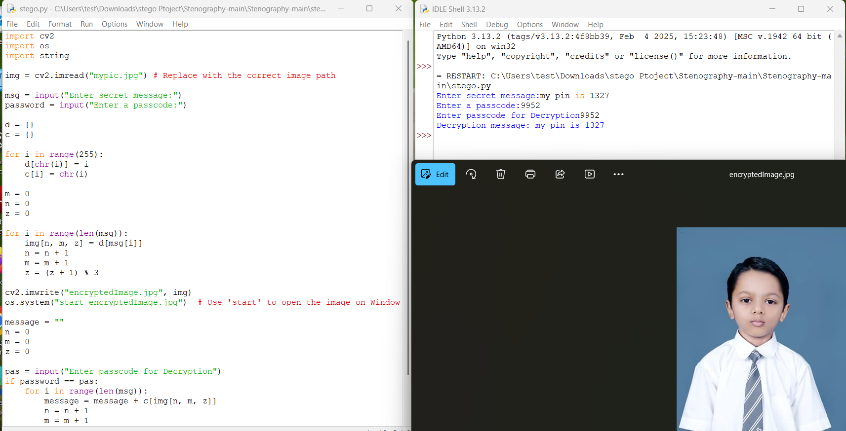
Results

Slide 8
Conclusion
Conclude your project concerning your problem statement
In this project, we successfully implemented a steganographic system that enables secure communication by concealing messages within digital media. The proposed method ensures a balance between imperceptibility, capacity, robustness, and security, making it a viable alternative to traditional encryption techniques.
Through testing, we verified that the hidden messages remain undetectable to the human eye and can be reliably extracted without significant degradation of the cover medium.
While the project achieves its primary objectives, there are opportunities for further enhancement, such as improving robustness against advanced attacks, increasing embedding efficiency
Overall, this project highlights the practical applications of steganography in secure communication.

Slide 9
GitHub Link
Make sure that there should be readme file

Slide 10
Future scope(optional)
Applications in Cybersecurity and Digital Forensics
AI-Powered Steganography and Detection
Use in Emerging Technologies
Improved Robustness Against Attacks

Slide 11
THANK YOU

